Slide 1



Expt 1. - Encryption-Decryption programs
Three Activities
1. Substitution Cipher
2. Transposition Cipher
3. Virtual Lab Activity ( Breaking shift Cipher and Mono alphabetic Cipher)

Slide 2
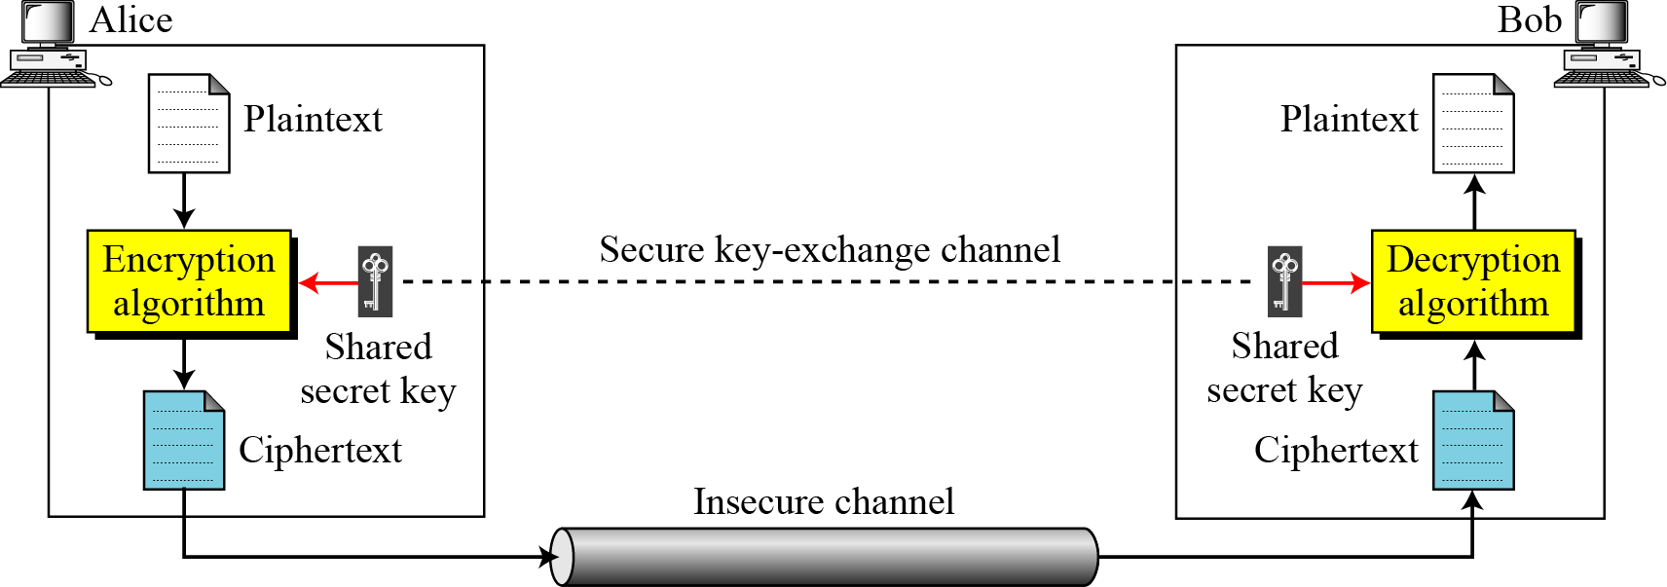
Expt 1. - Encryption-Decryption programs
Symmetric Key Cipher

Slide 3
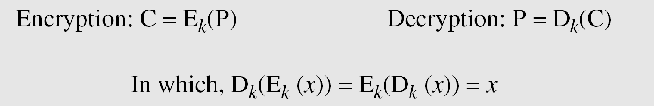
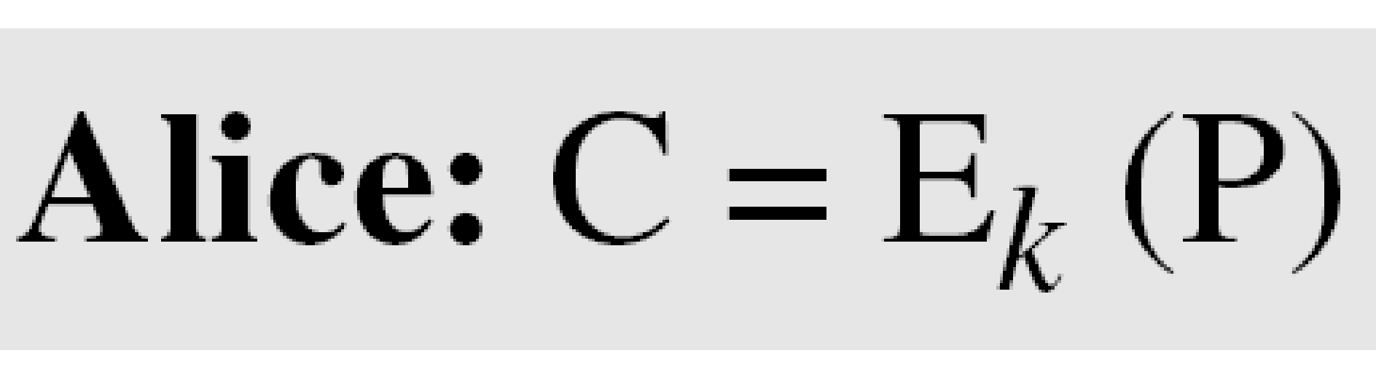
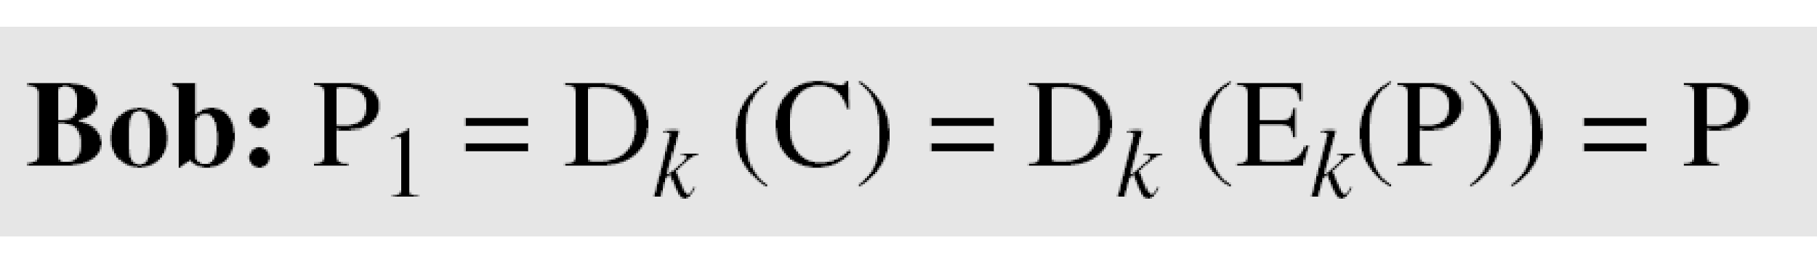
Symmetric Key Cipher
If P is the plaintext, C is the cipher text, and K is the key,
We assume that Bob creates P₁; we prove that P₁ = P:

Slide 4
Substitution Cipher
A substitution cipher replaces one symbol with another. Substitution ciphers can be categorized as either monoalphabetic ciphers or polyalphabetic ciphers.
In monoalphabetic substitution, the relationship between a symbol in the plaintext to a symbol in the ciphertext is always one-to-one

Slide 5

Substitution Cipher
Example 1 :
The following shows a plaintext and its corresponding ciphertext. The cipher is probably monoalphabetic because both l’s (els) are encrypted as O’s.

Slide 6
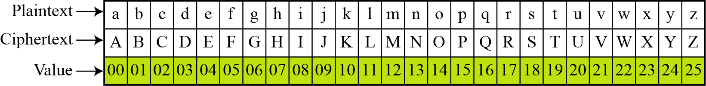
Substitution Cipher - Additive Cipher
The simplest monoalphabetic cipher is the additive cipher. This cipher is sometimes called a shift cipher and sometimes a Caesar cipher, but the term additive cipher better reveals its mathematical nature.
Figure Plaintext and ciphertext in Z26

Slide 7
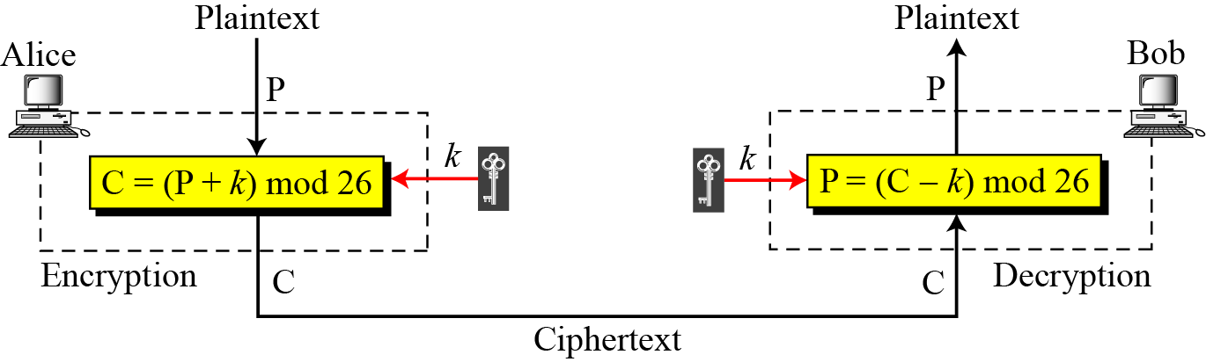
Substitution Cipher - Additive Cipher

Slide 8
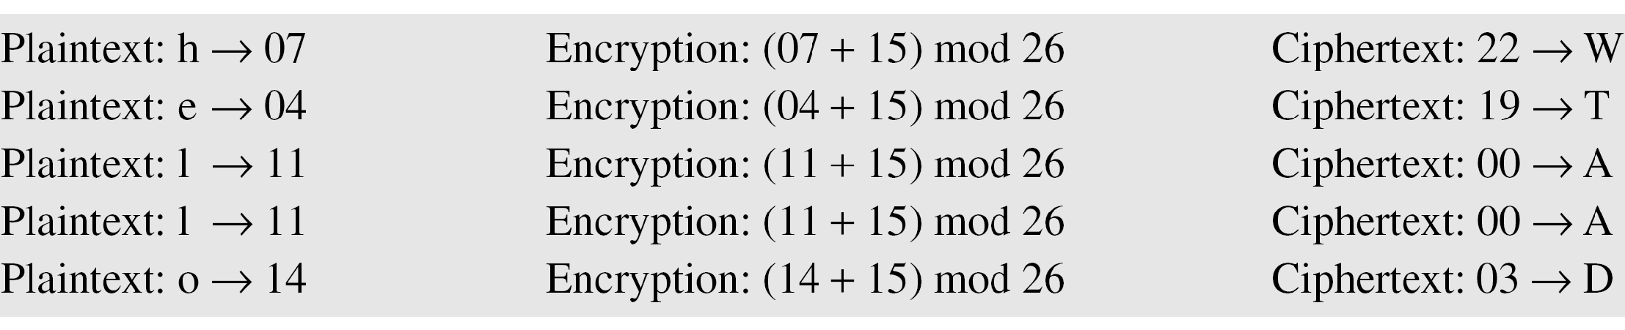
Substitution Cipher - Additive Cipher
Example Use the additive cipher with key = 15 to encrypt the message “hello”.
Solution
We apply the encryption algorithm to the plaintext, character by character:

Slide 9
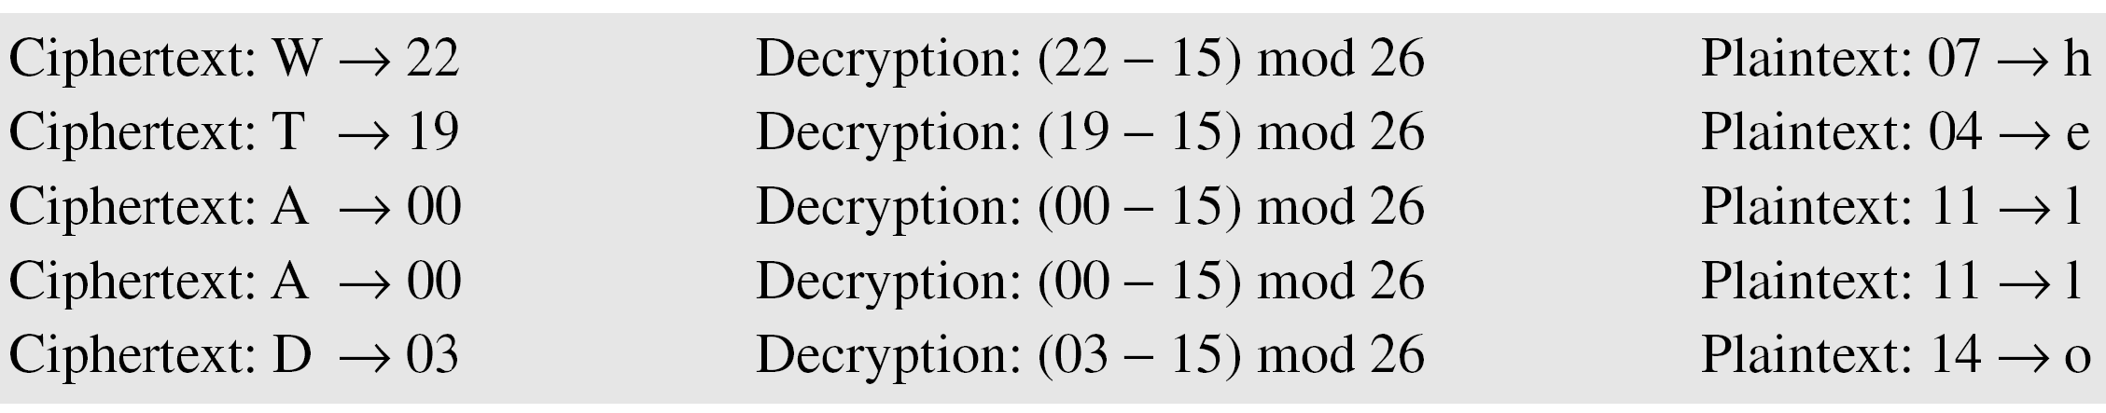
Substitution Cipher - Additive Cipher
Use the additive cipher with key = 15 to decrypt the message “WTAAD”.
Solution
We apply the decryption algorithm to the plaintext character by character:

Slide 10
Shift Cipher and Caesar Cipher
Historically, additive ciphers are called shift ciphers. Julius Caesar used an additive cipher to communicate with his officers. For this reason, additive ciphers are sometimes referred to as the Caesar cipher. Caesar used a key of 3 for his communications

Slide 11
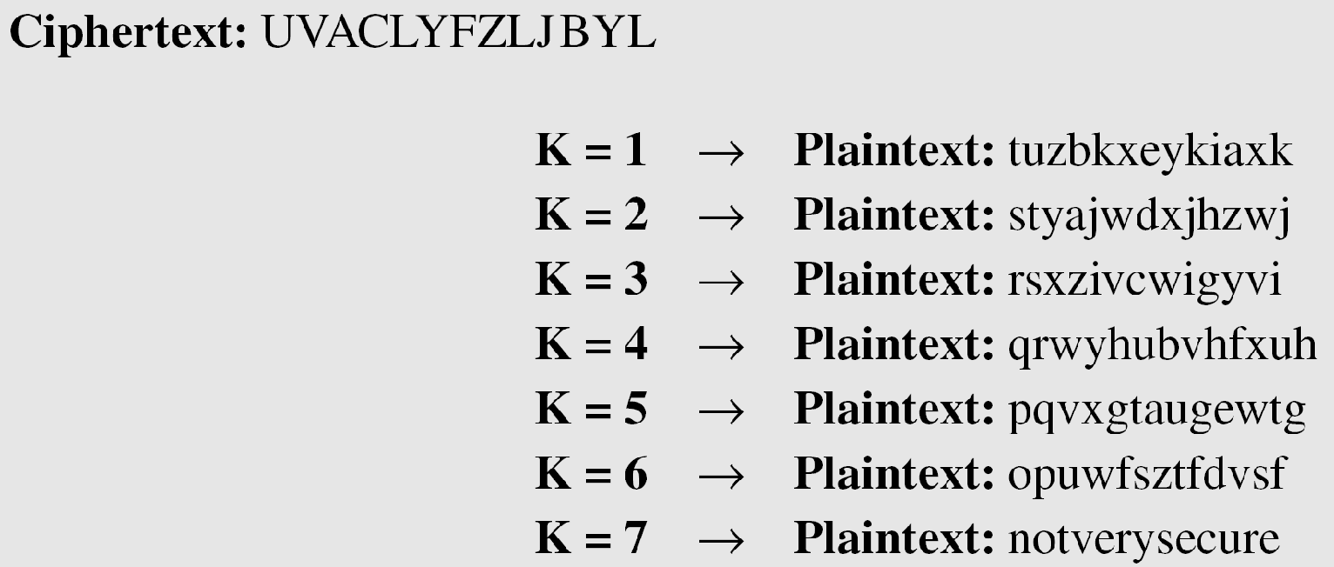
Breaking of Shift Cipher
Eve has intercepted the ciphertext “UVACLYFZLJBYL”. Show how she can use a brute-force attack to break the cipher
Solution
Eve tries keys from 1 to 7. With a key of 7, the plaintext is “not very secure”, which makes sense.

Slide 12
Activity 2 : TRANSPOSITION CIPHERS
A transposition cipher does not substitute one symbol for another, instead it changes the location of the symbols.
Keyless Transposition Ciphers
Keyed Transposition Ciphers
Combining Two Approaches

Slide 13
Keyless Transposition Ciphers
Simple transposition ciphers, which were used in the past, are keyless
Example
A good example of a keyless cipher using the first method is the rail fence cipher. The ciphertext is created reading the pattern row by row. For example, to send the message “Meet me at the park” to Bob, Alice writes
She then creates the ciphertext “MEMATEAKETETHPR”.

Slide 14
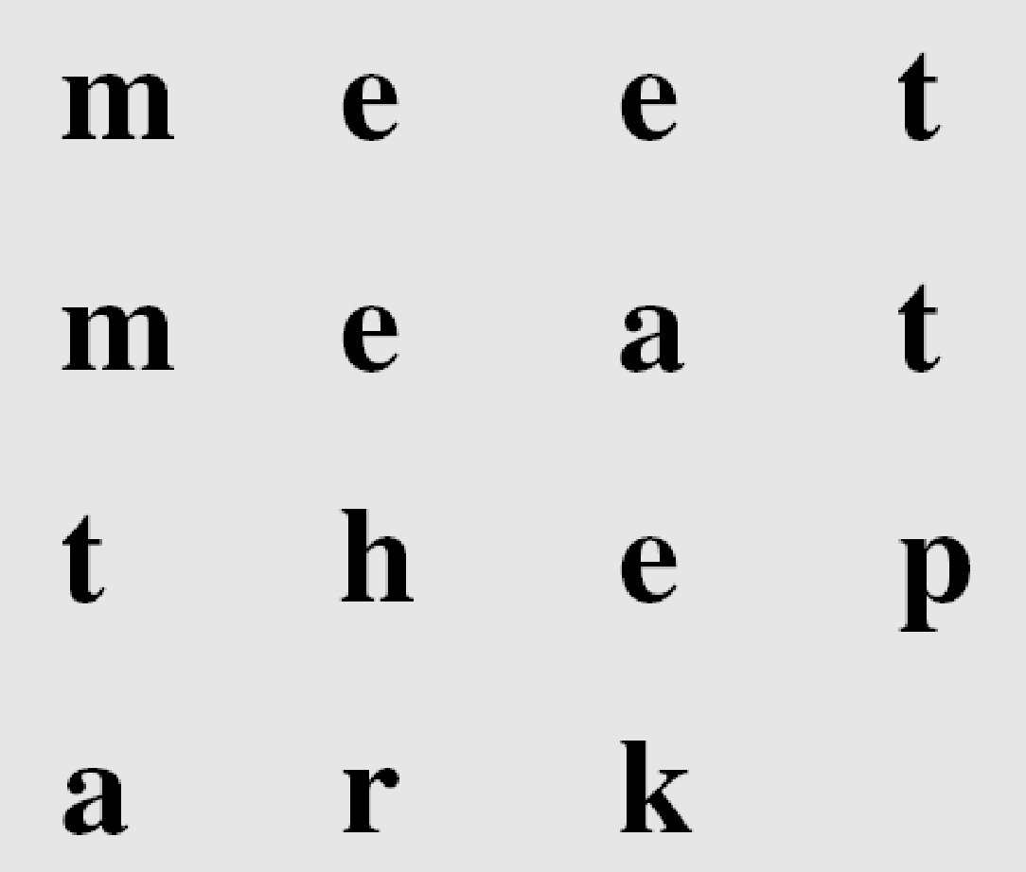
Keyless Transposition Ciphers
Example 2
Alice and Bob can agree on the number of columns and use the second method. Alice writes the same plaintext, row by row, in a table of four columns.
She then creates the ciphertext “MMTAEEHREAEKTTP”.

Slide 15
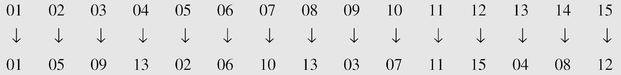
Keyless Transposition Ciphers
Example 3
The following shows the permutation of each character in the plaintext into the ciphertext based on the positions.
The second character in the plaintext has moved to the fifth position in the ciphertext; the third character has moved to the ninth position; and so on. Although the characters are permuted, there is a pattern in the permutation: (01, 05, 09, 13), (02, 06, 10, 13), (03, 07, 11, 15), and (08, 12). In each section, the difference between the two adjacent numbers is 4.

Slide 16
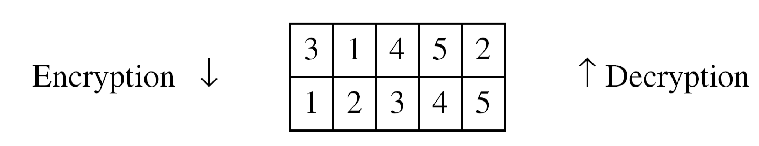
Keyed Transposition Ciphers
Alice needs to send the message “Enemy attacks tonight” to Bob..
The key used for encryption and decryption is a permutation key, which shows how the character are permuted.
The permutation yields

Slide 17
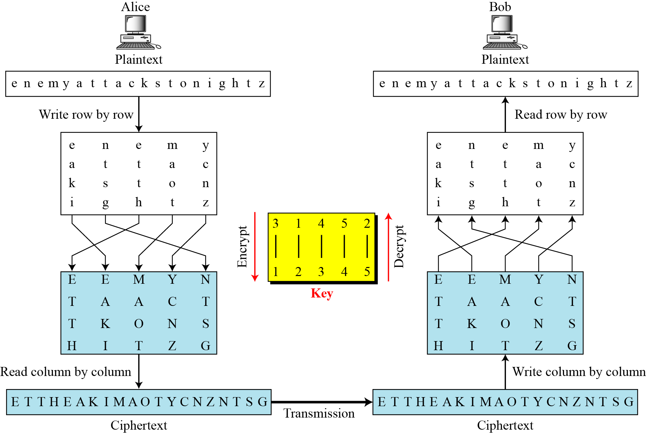
Combining Two Approaches

Slide 18
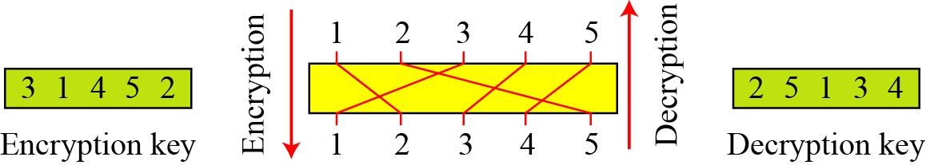
Combining Two Approaches
In Previous Example, a single key was used in two directions for the column exchange: downward for encryption, upward for decryption. It is customary to create two keys.
Figure Encryption/decryption keys in transpositional ciphers

Slide 19
Activity 3 – Virtual Lab
http://cse29-iiith.vlabs.ac.in/exp1/Quizzes.html?domain=Computer%20Science&lab=Cryptography%20Lab

Slide 20
Lets Begin…
Over to You and Perform Practical

